Slide 1

Mini Project –Semester III Internal Presentation Part - 1
Title: On Road Vehicle Breakdown Assistance System
BY:
Prajyot Bhoir Dhanvi Mange Abhishek Shinde
Roll no : 119A3011 Roll no: 119A3013 Roll no: 119A3003
Under the guidance of
Ms. Seema Redekar
Department of Information Technology
SIES Graduate School of Technology, Nerul

Slide 2
Index
Index
Introduction
Literature survey
Existing system
Proposed system
Problem definition
Hardware and software requirements
System Architecture
Applications
Conclusion
References
Project Title

Slide 3
Introduction
The Challenges involved when the vehicle comes to a halt in unexpected circumstances are many. In such an adverse situation, user may not exactly know the location to find the nearest available mechanic. Today most of people use their own vehicle for travel. While traveling most of drivers face the trouble of vehicle breakdown on the road. Vehicle breakdown leads to wastage of the user’s valuable time. When the driver encounters a vehicle breakdown on the road, the driver has to search for mechanic and has to look for a spare-part shop near to their location. At that time if driver is unable to search a good mechanic, they have to ask for help from someone.
But if a driver has an android phone and uses this vehicle breakdown assistance, user can find suitable mechanic within a few minutes. The advantage of using the vehicle breakdown assistance is that the user can find a mechanic on the basis on its location

Slide 4
Literature Survey
SR. No. | Author | Title & Publication | Key Findings
i. | Kumaravel Haridas, Ahmad Suhaimi Baharudin. | Indian Journal of Science and Technology | The existing manual process is not able to address the request effectively.
ii. | Kamal Karkonasas | Indian Journal of Science and Technology | User does not have any reporting features that reviews the service that was engaged.

Slide 5
Existing System
In an existing system there are users who have their own mechanic database which is very minimal. And also they have no idea if their vehicles are broke down or had any mechanical issue in remote locations or any long distant locations from their known mechanic shops.
Users with the contacts of people at the particular place may look for a help from them only if they are ready to do.
It is not possible to find out the suitable mechanic for the desired service at remote locations. The only way they have is to look for any other transportation at the time of issue and then they need to get a mechanic to the particular location at which they have left their vehicle.

Slide 6
Proposed System
Here the users of On Road Vehicle Breakdown Assistance system can search for list of mechanic at any location or the nearby locations which will help them in an unexpected situations raised by the mechanical issues of their vehicles.
Only the licensed mechanics can get listed here during the search and the available mechanic can come and repair the mechanical issues in the users vehicle. Also the mechanics are under monitoring by the system for not charging any extra service fee from the users as every user is updating their feedback about the availed service through system.

Slide 7
Problem Definition
The system after careful analysis has been identified to be presented with the following modules User, Owner and Mechanic.
A user can register or log in by providing details like name, email-id, password, mobile number and location.
A user has a vehicle. He has to specify the type, model name, vehicle number and engine type of the vehicle.
There will be a business owner who will register.
The business owner has mechanics working under him.
The mechanic has name ,services availability, mobile number and its unique id. A user can call the mechanic according to his issue.
A user at the end can give feedback. Feedback may contain rating, unique id and description.
A owner can view the feedback given by the user and thus improve the services of the mechanics.

Slide 8
User
Register – User has to register their basic details to get access with this application service.
Login – Once they have registered, they need to login to avail the service at the needy time.
Vehicle – The user can add the vehicle details for which he wishes the services to be provided.
Enter the location– Logging in with the application will enable you to enter the location where the vehicle has been broken down.
Search records of mechanics – The users can search the mechanic among the list according to their place and time.
Post feedback – After all the process every user has to give their feedback with this application to about their adopted service through this medium.
Owner
Register – Owner has to register their basic details to get access with this application service.
Login – Once they have registered, they need to login to provide their mechanics for providing services.
Add or Delete Mechanic – Administration has to add the mechanic after verifying their licensing details for the effective service. He can also delete the mechanic details in future.
View feedback – Using the feedbacks provided by the users/customers of the service the owner can ask the mechanics to maintain or improve their service.

Slide 9
Software Requirements
Operating System: Windows 7 and above
Language: JAVA
Database: PostgreSQL
IDE: Intellij
Browser: Google Chrome

Slide 10
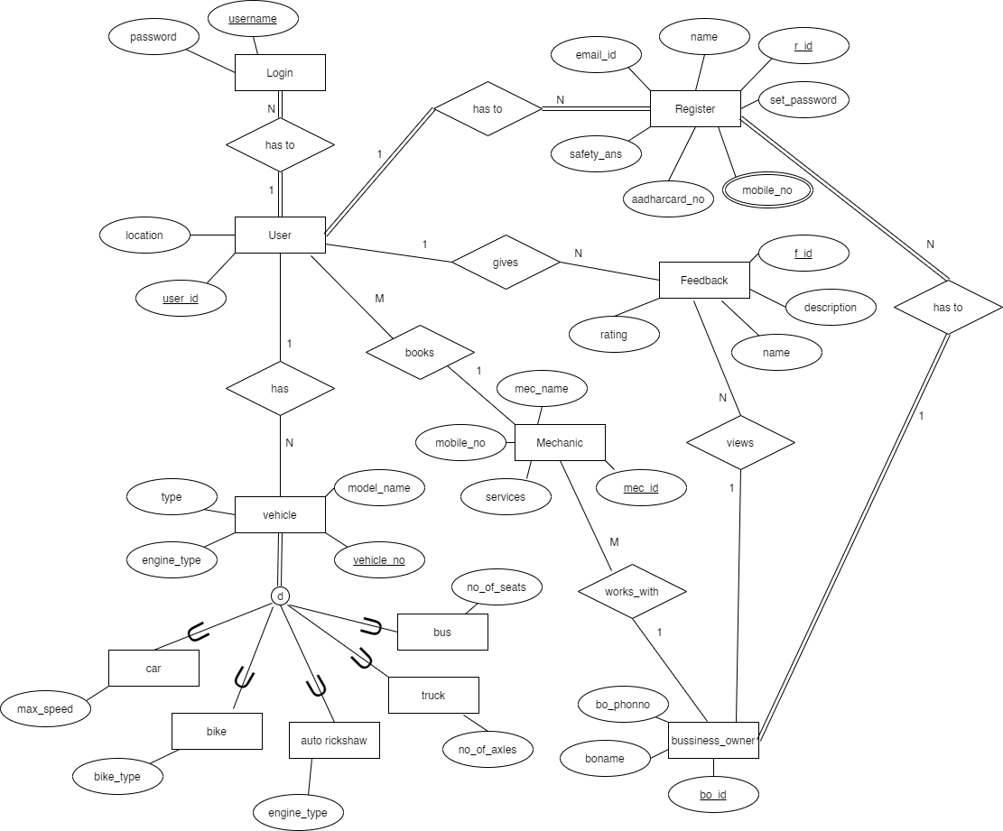
System Architecture

Slide 11
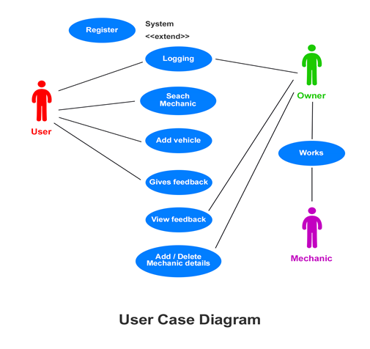
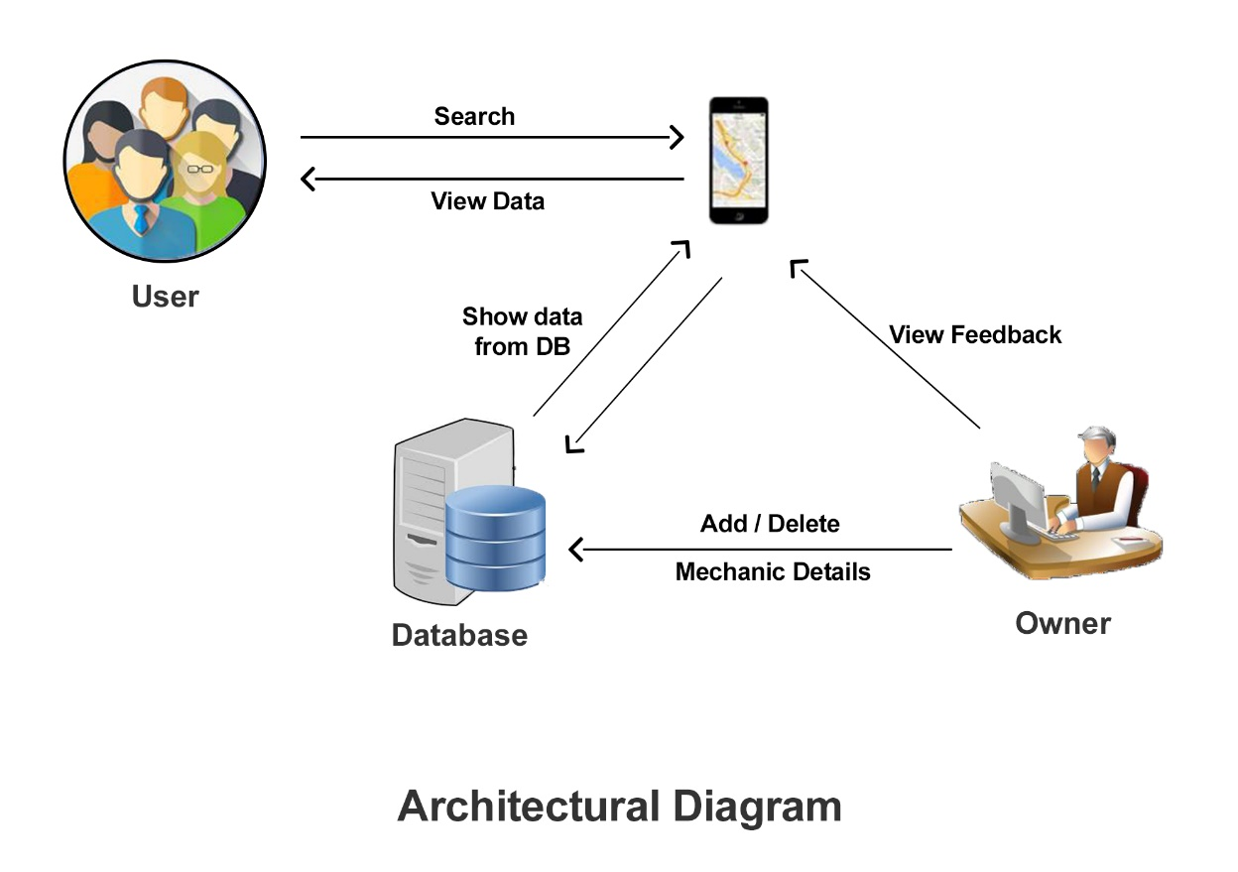
System Architecture

Slide 12
Applications
To build a common platform that connect with mechanic and driver.
Secure registration of user’s and mechanics.
Easy access to the data.
The new system is more user-friendly, reliable and flexible.
Reduced manual work.
Search mechanics based on different locations.
This application can be used by the small or large organization.
To identify the reason for vehicle breakdown.
To design a web ontology that can identify a suitable mechanic.

Slide 13
Conclusion
While the chances of a properly maintained vehicle experiencing a breakdown are slim, it is never a possibility to predict when the user may experience a vehicular breakdown. The application developed here promises to make the life of a vehicle owner that much easier, as even in the probability of a breakdown, the vehicle owner is assured of the fact that he has a solution to the problem within a few steps of entering details in his smart phone he can save himself from a major setback in such an undesirable situation. The proposed system promises to act as a source of protection against the unpredictability of a vehicular breakdown and offers the owner of a particular some peace of mind in the event of operational failure of the user’s vehicle.

Slide 14
References
https://codeshoppy.com/shop/product/on-road-vehicle-breakdown-assistance-app/
https://www.tutorialspoint.com/index.htm
https://www.javatpoint.com
https://patents.google.com/patent/US6972669B2/en
https://www.youtube.com/watch?v=XAowXcmQ-kA&t=1693s

